Slide 1
Overview and Organization of Case Study Content
State of Practice:
Global Testing
Application Scenarios
Overview of Current Load Testing Guidance (AASHTO MBE)
Summary of Selected
Case Studies:
Load Testing for Rating
Shortcomings of Current
Load Testing Guidance
Deterioration from Structural Responses
Reinforced Concrete Multi-Girder Bridge
Best Practice Approach to
Load Testing (St-Id)
Excessive Vibration
Steel Multi-Girder Bridge
Concrete Encased Steel Multi-Girder Bridge

Slide 2
State of Practice
Current Guidance
Summary of guidance provided by the AASHTO Manual for Bridge Evaluation
Diagnostic-level
Proof-level
Summary of relevant sections from Manual for Refined Load Rating
Guidance Shortcomings
Implicit Inclusion of Uncertain Mechanisms
Uncertain Location of Maximum Responses
Safety Concerns during Proof-Level Tests
Best Practice Approach
Summary of sensors, equipment and technologies
Introduction of framework for load testing
Steps to ensure adequate data quality
Challenges associated with each step of the load rating process.

Slide 3
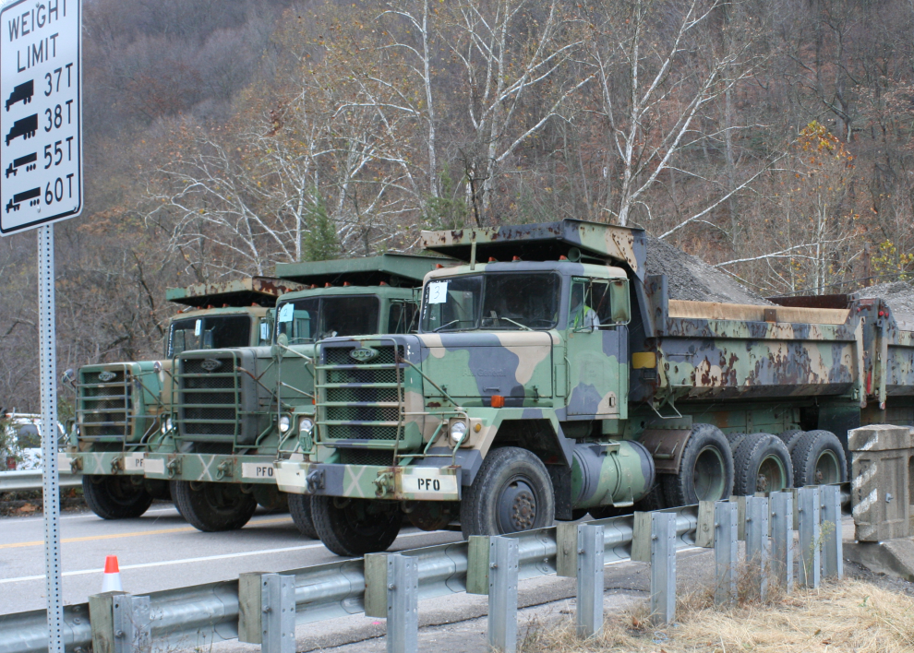
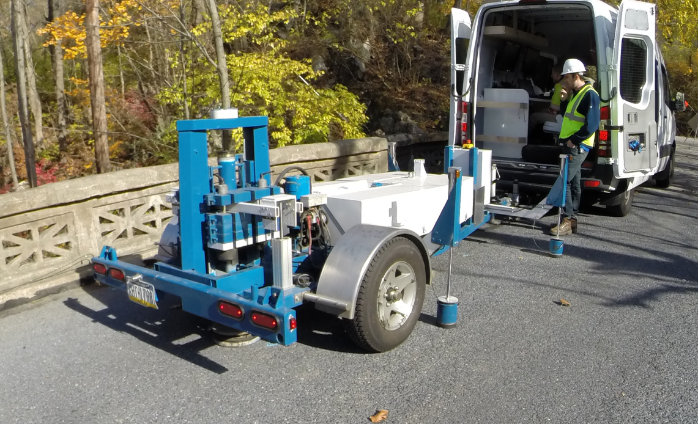
Case Studies
For each structure a detailed description of the following items will be provided:
Structure Overview
Motivation for Testing
Finite Element Modeling
Experimental Program and Results
Updating Rating and Discussion

Slide 4
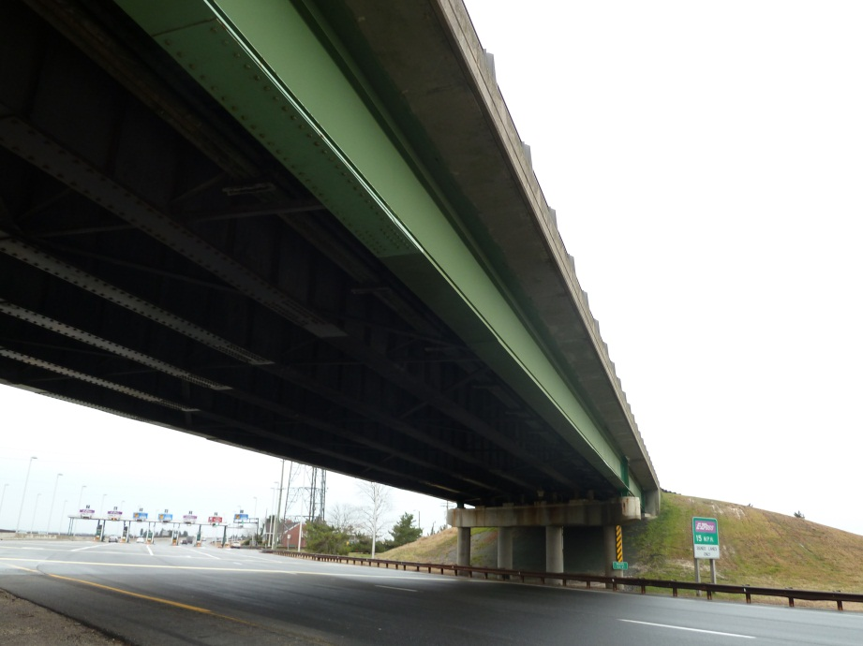
Case Study 1: Steel Multi-Girder
Poor detailing of cover plates required posting for load.
Bridge on an obsolete route
Bridge owner needed to provide access to constructions traffic
Load testing as alternative to bridge modification or replacement.

Slide 5
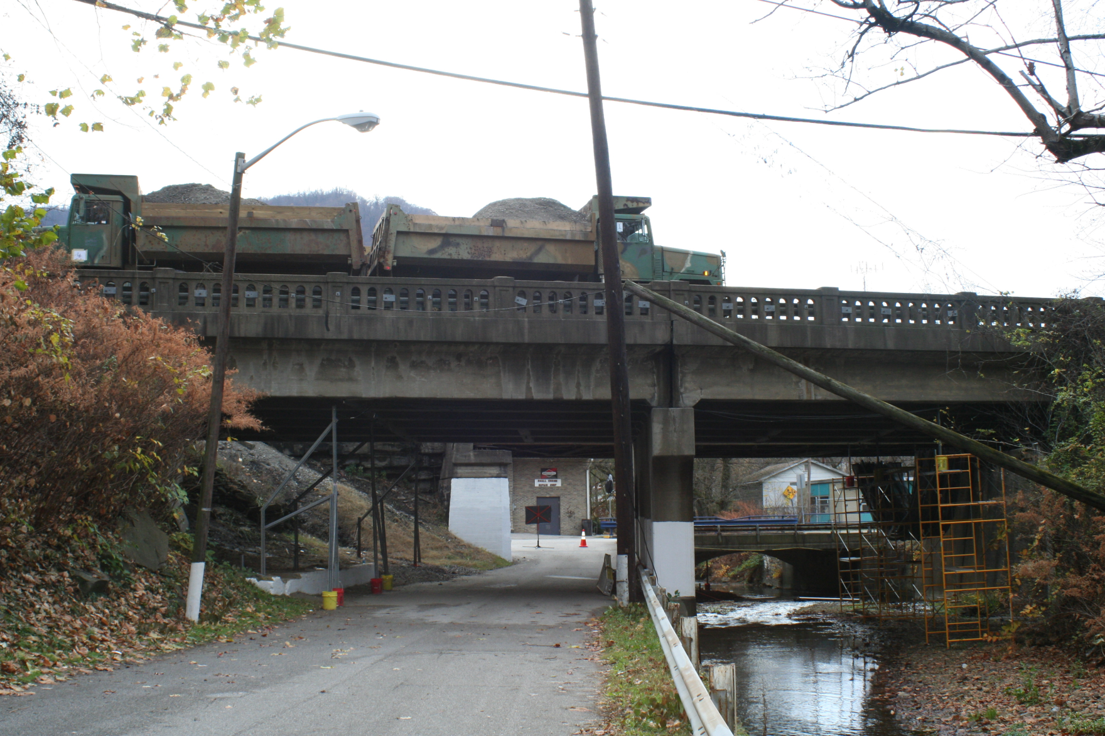
Case Study 2: Reinforced Concrete Multi-Girder
On an established coal route
Wished to remove load posting
Visible signs of deterioration
Spalling
Corroded re-bar
Proof-level load test conducted – 604 kips

Slide 6
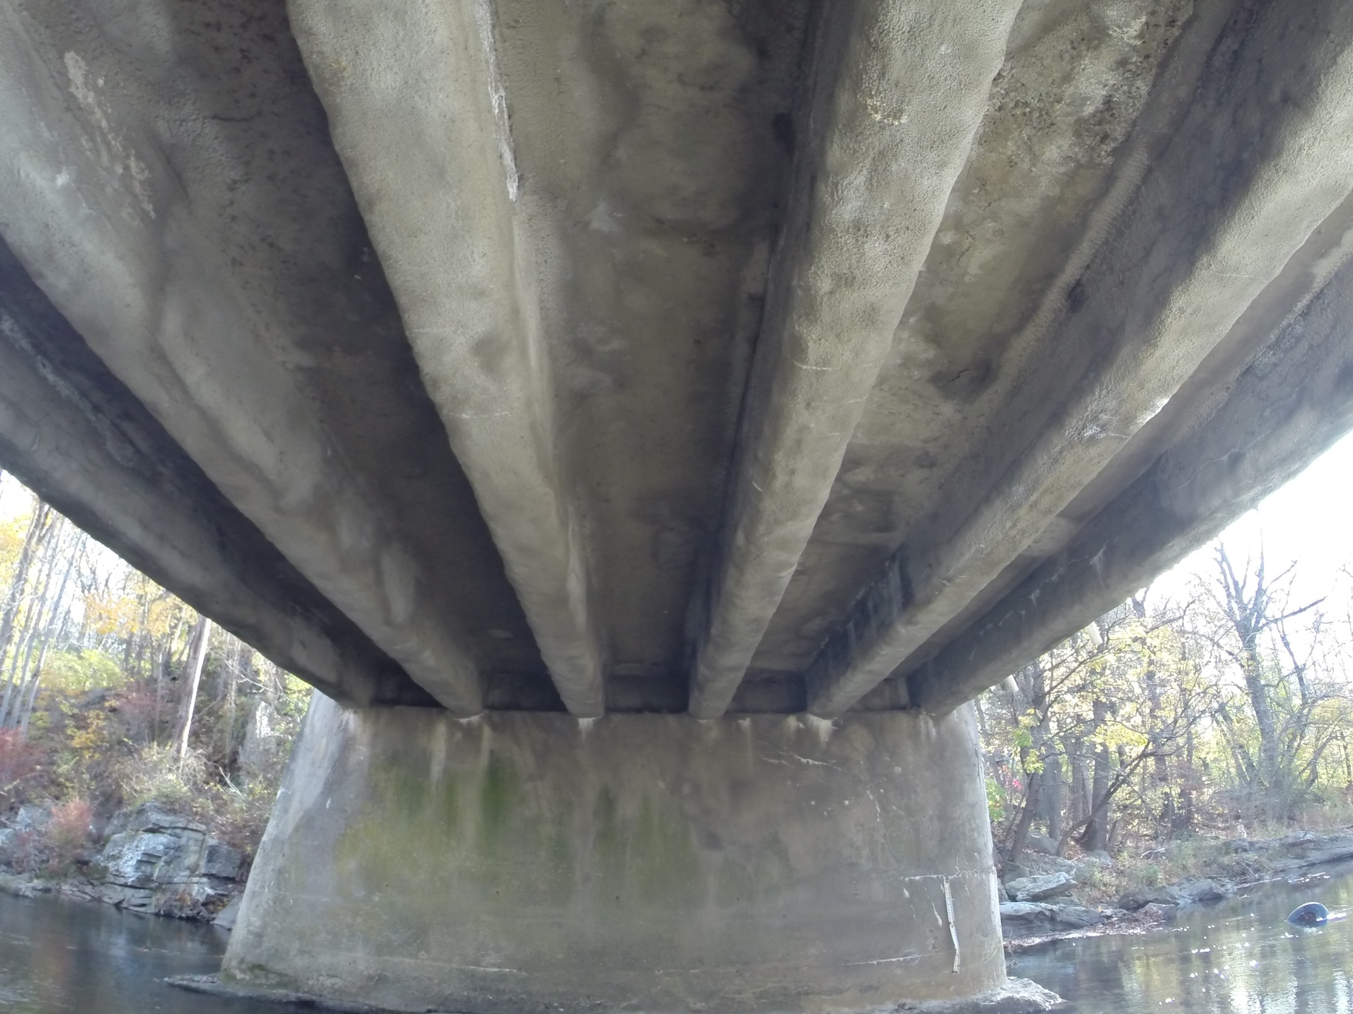
Case Study 3: Concrete Encased Steel Multi-Girder
Steel girders with unknown dimensions encased by concrete
Concrete not permitted to contribute to capacity
Dynamic diagnostic load testing to show that the structure “rates”

